Slide 1
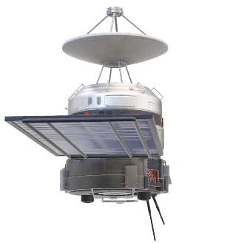
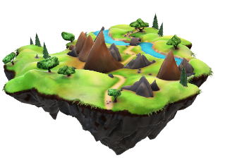

Slide 2
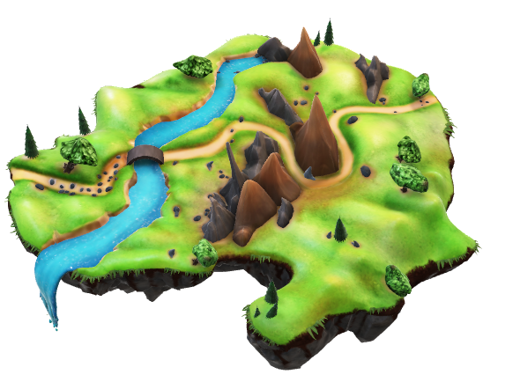
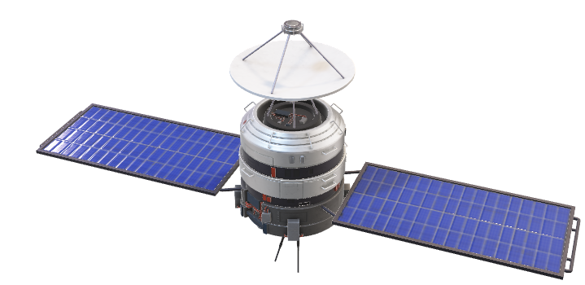
Telangana Forest Analysis
Using Data Cubes

Slide 3
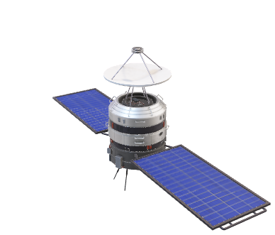
Problem Statement
The State of Telangana is endowed with rich diversity of Flora and Fauna.
The forests in Telangana belong to three Forest Type Groups, which are further divided into 12 Forest Types.
A data cube based forest monitoring and management system is need for the state government.
Our plan is to develop a special data cube to study
Change In The Forest Cover
Burnt Area Estimation and vegetation analysis.

Slide 4
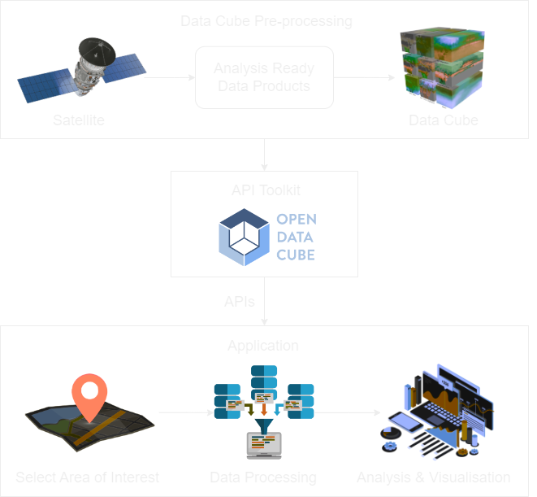
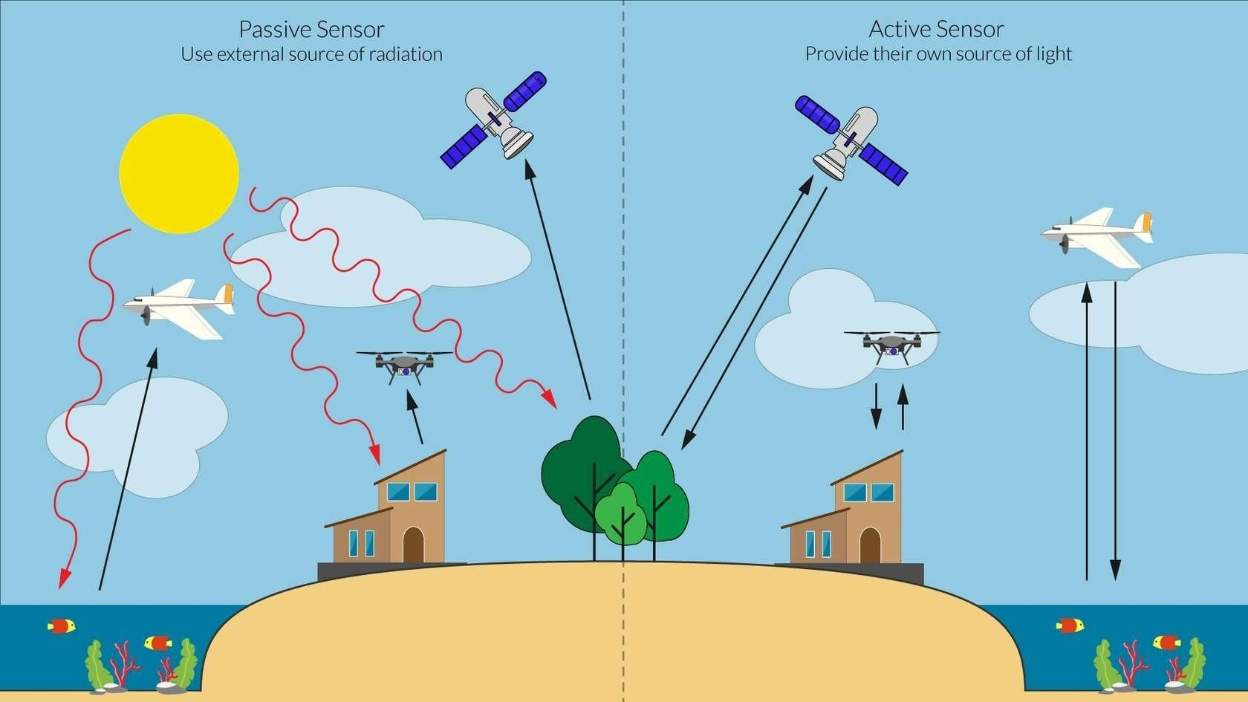
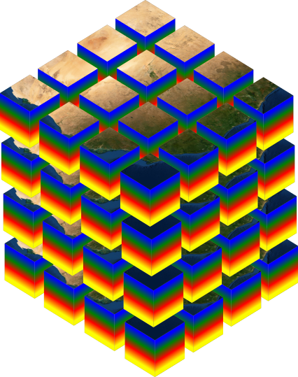
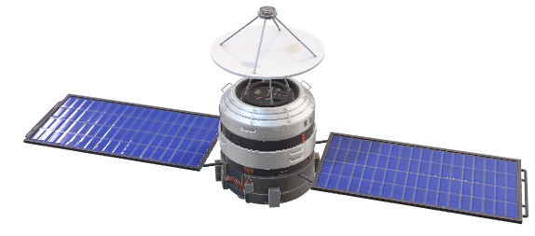
Introduction
Remote sensing – Collecting and analyzing data about the Earth's surface without physically being in contact with it, typically using aircraft or satellites.
Data Cube – A collection of multi-dimensional data sets organized for efficient querying and time series analysis of data along multiple dimensions.

Slide 6
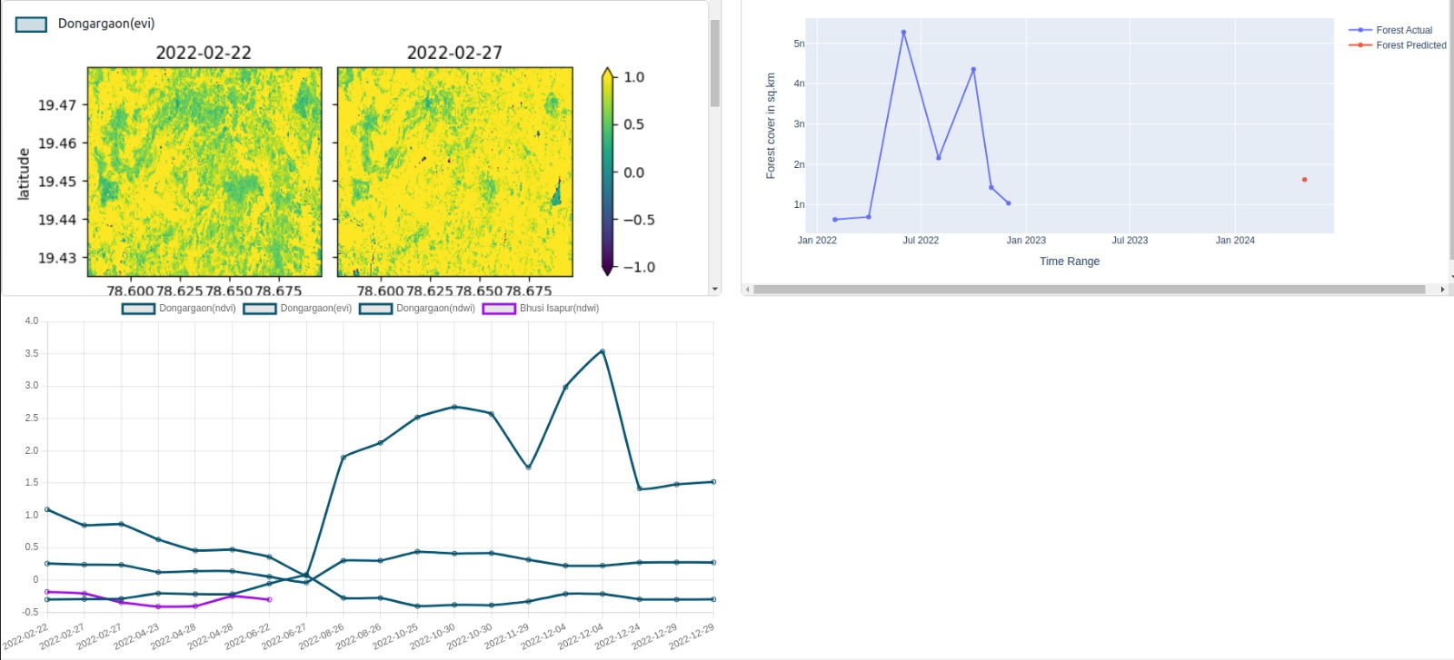
Results

